Slide 1

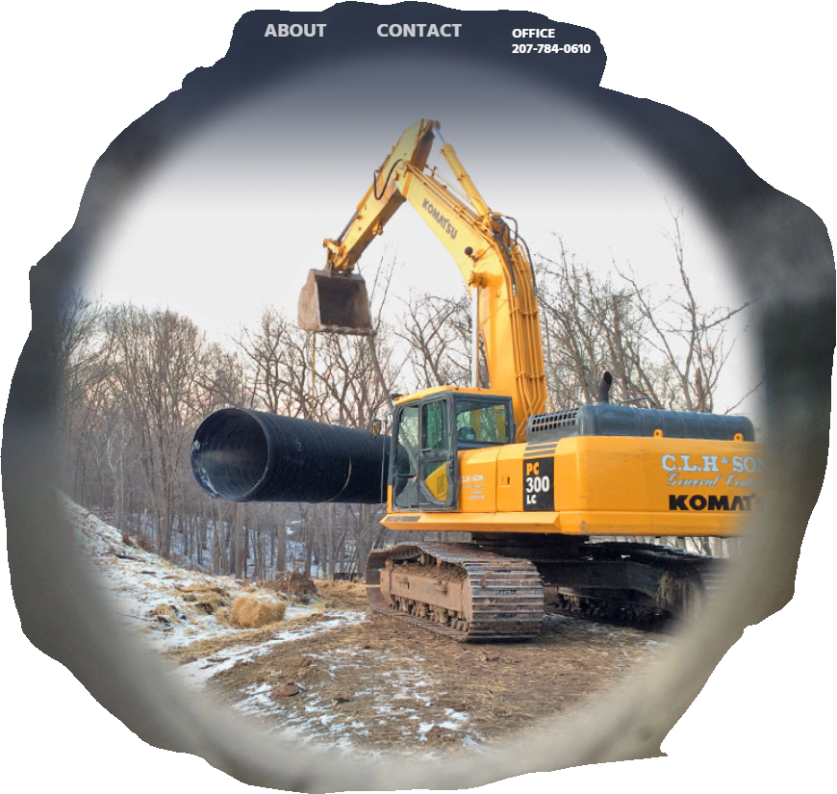
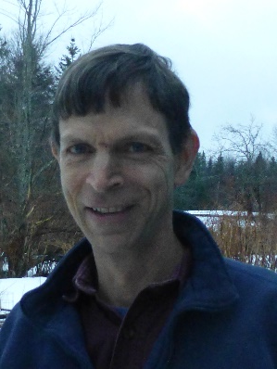


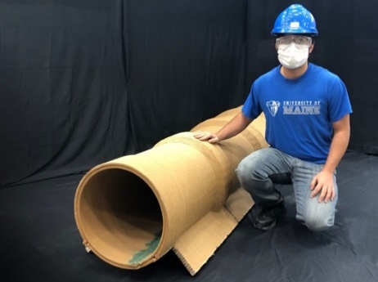
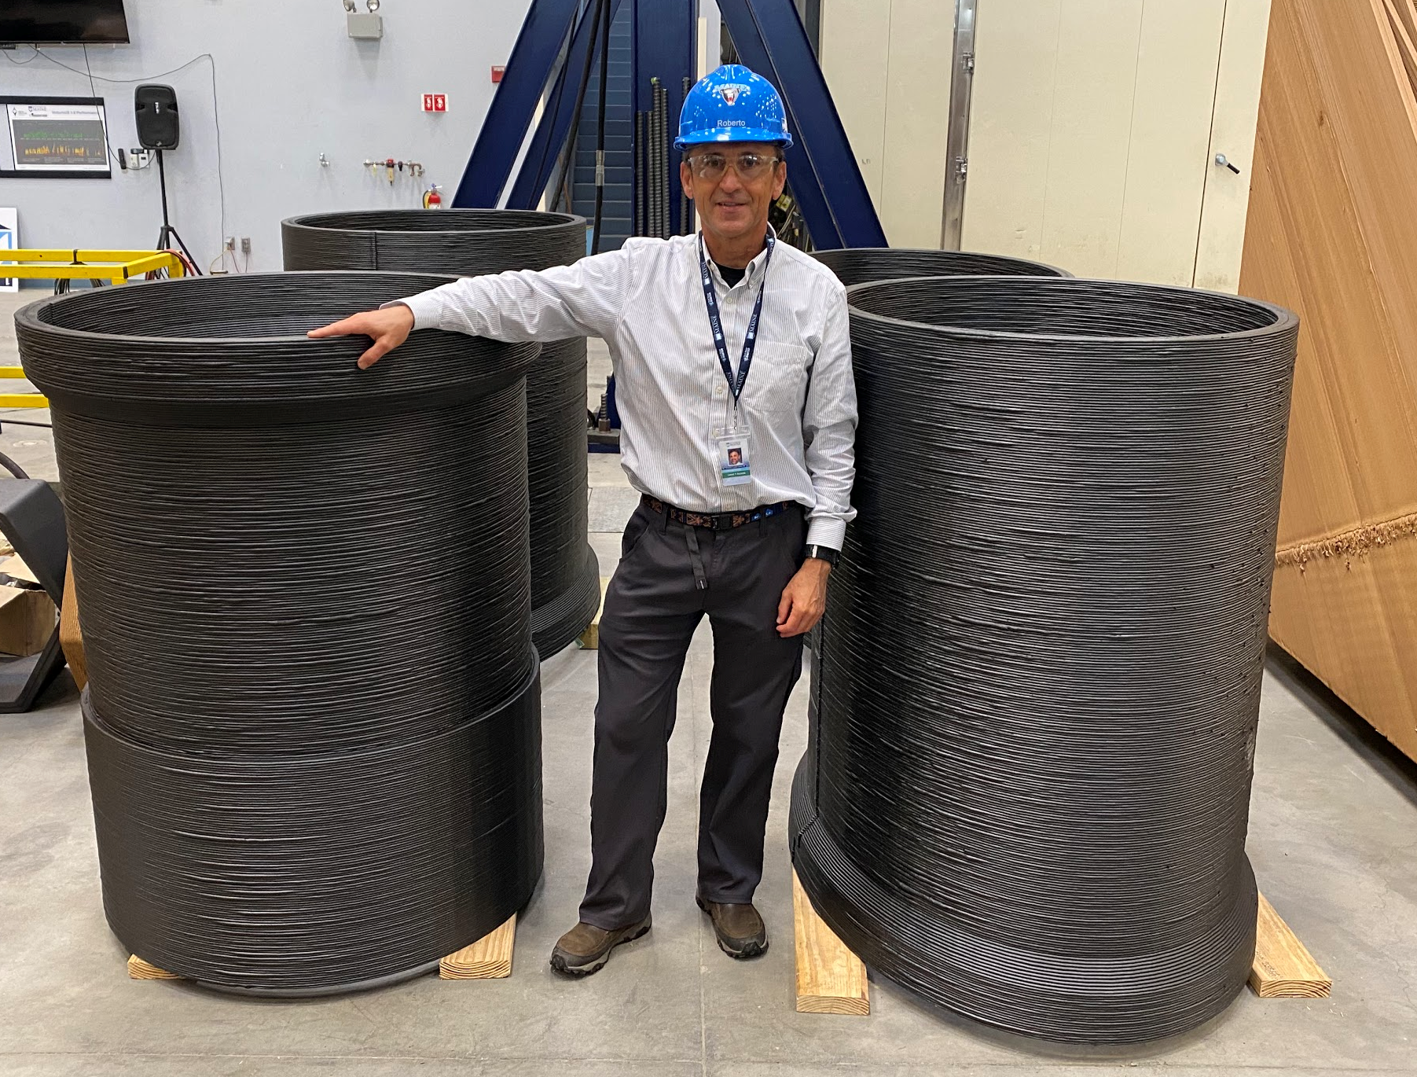

Culvert Diffuser System
2024 NHEC, Biloxi MS
Collaborators
Alex Mann, PG, Maine DOT
Roberto Lopez Anido, PhD
Sunil Bhandri, PhD
Don LeBlanc, PE, DLVEWS Inc.
Travis Stearns, CLH & Son Inc.
Charlie Hebson, PE, PhD
Tim Mallette, PE, NHDOT
Transportation Infrastructure in Coastal Fringe Floodplain
Exeter NH
www.tidc-utc.org

Slide 2

Culvert Rehab under Deep Fill in Coastal NH
42” (3.5’) Diameter CMP rehabilitation liner system
Location: Rocky Hill Brook, NH 85/Newfields Rd, Exeter, NH
Problem:
Existing culvert is undersized by modern standards
Rehab culvert even more undersized:
reduced diameter & hydraulic capacity
Climate change – increasing design flows?
How to recapture some of the lost capacity?
CONSIDER OUTLET DIFFUSER SYSTEM

Slide 3
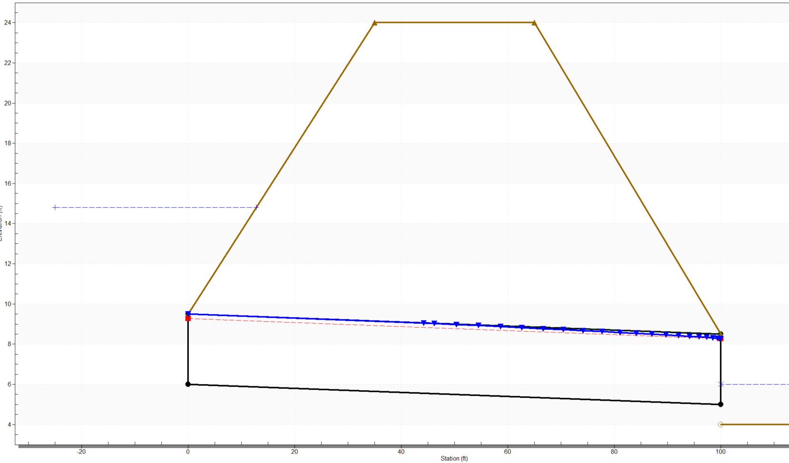
Illustrative HY-8 Model – Exeter Culvert Capacity & Performance
Liner 34” (overtopping)
(8” reduction in D assumed)
A_{ws} = 0.41 mi²
Q50 = 123 ft³/s
By StreamStats
Existing 42” CMP

Slide 4
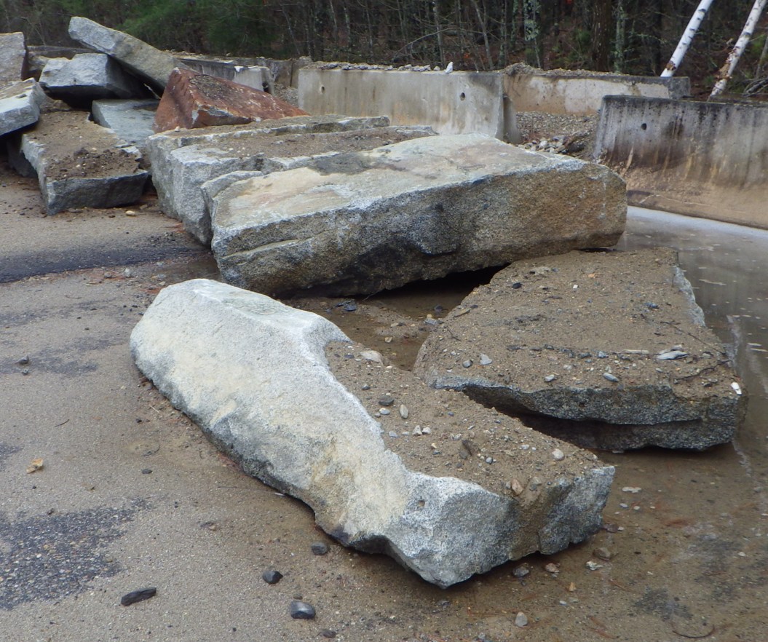
Collaboration Idea
Culvert outlet diffuser for 42” dia. CMP rehabilitation liner system
Proposed solution: 3D printed culvert diffuser manufactured @ University of Maine by segments and assembled at the site.
Additional system components included:
New inlet header w/ HydroBell (“improved inlet”)
Smooth bore HDPE liner pipe (SnapTite)
University of Maine: Advanced Structures & Composites Center and Transportation Infrastructure Durability Center (TDIC)

Slide 5
Suitable Site Conditions for Diffuser Application
Performance Related
Channel slope
Tailwater for submergence of outlet at peak design flow
Velocity head in approach pipe / headwater depth
Anticipated Diffuser System benefits
  increase in pipe capacity of 30 – 35% can be realized
  decrease in outlet velocity compared to other options
  resilience for increased design flows due to climate change
Advantages for Site Constraints such as:
High embankments that are difficult to excavate below inverts
High traffic areas

Slide 6
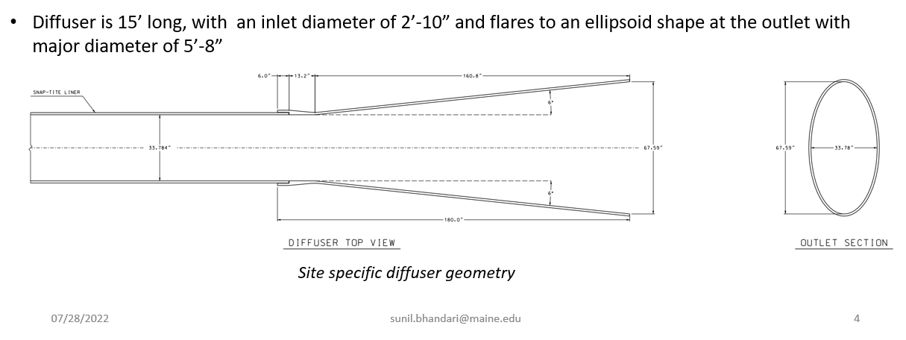
Alex Mann’s Diffuser Design for Small D Pipes
Flared Outlet to Reduce Expansion Losses

Slide 7
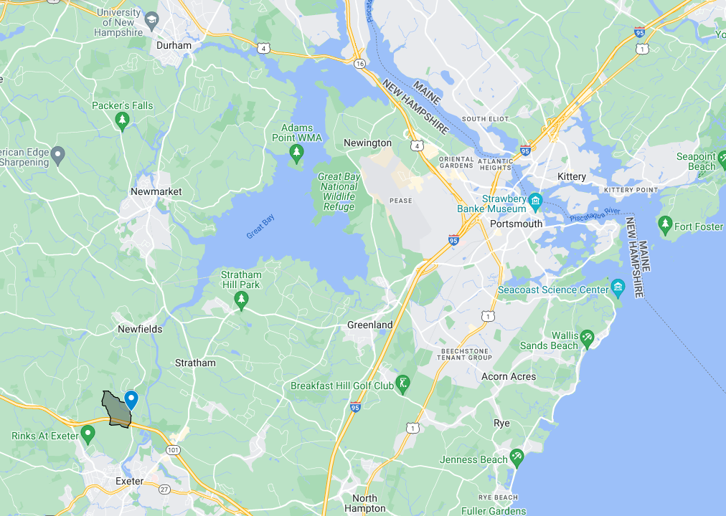
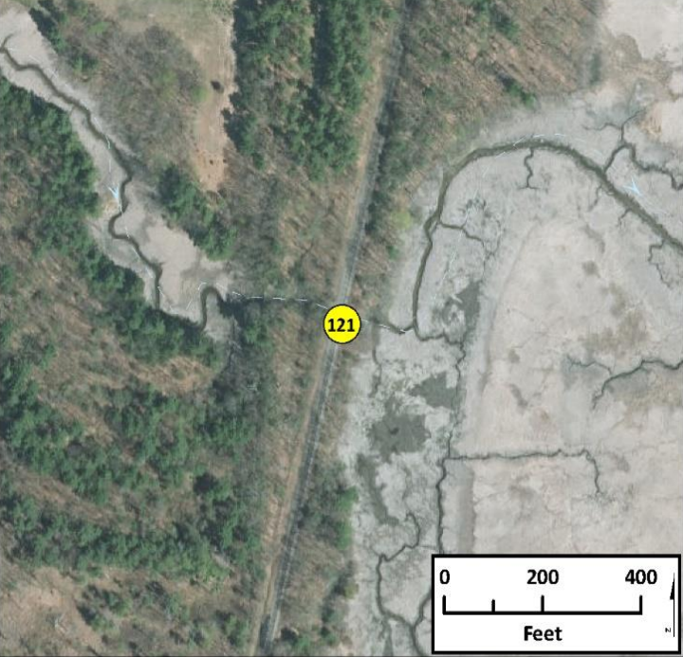
Project Vicinity Portsmouth-Exeter Seacoast NH
Project

Slide 8
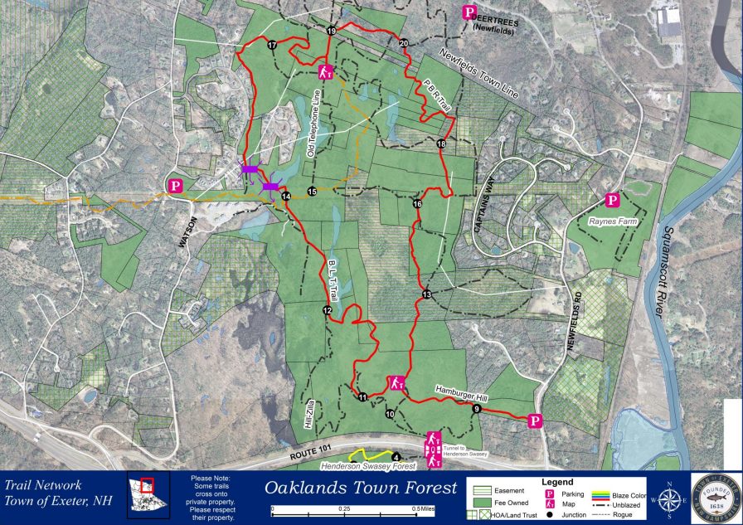
Project Vicinity North of NH Rte. 101

Slide 9
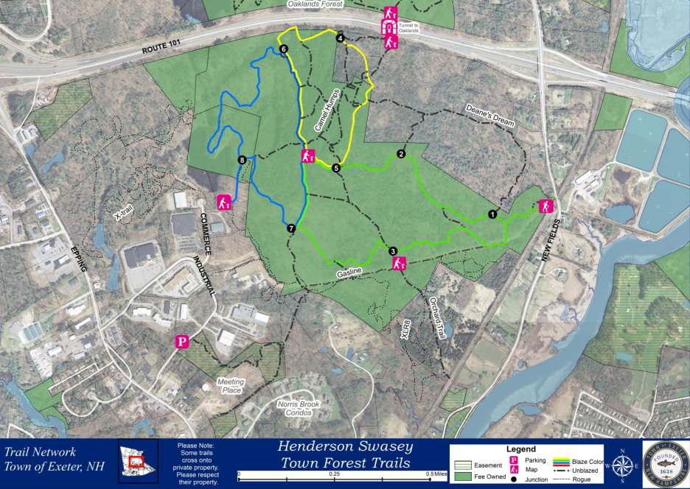
Project Vicinity South of NH Rte. 101

Slide 10
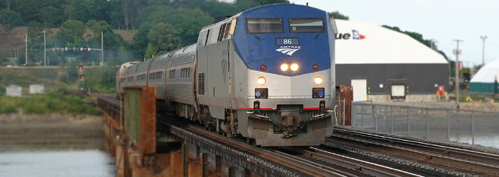

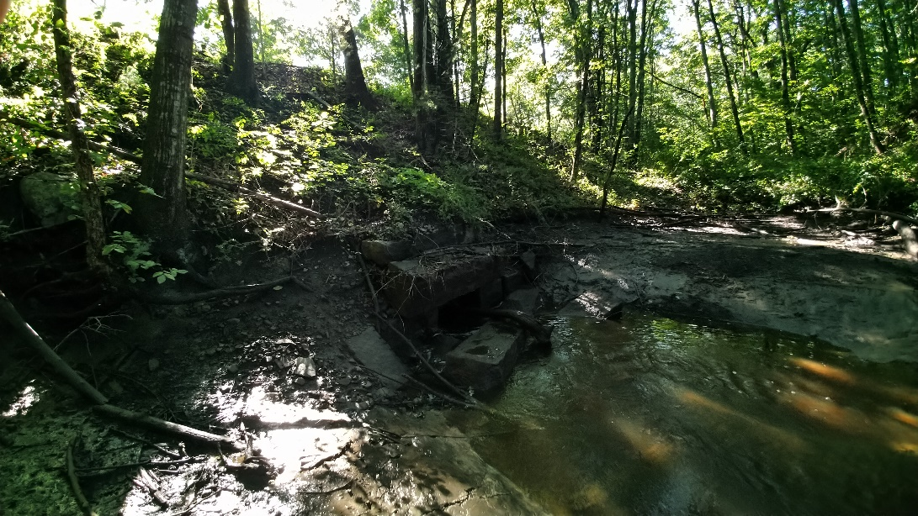
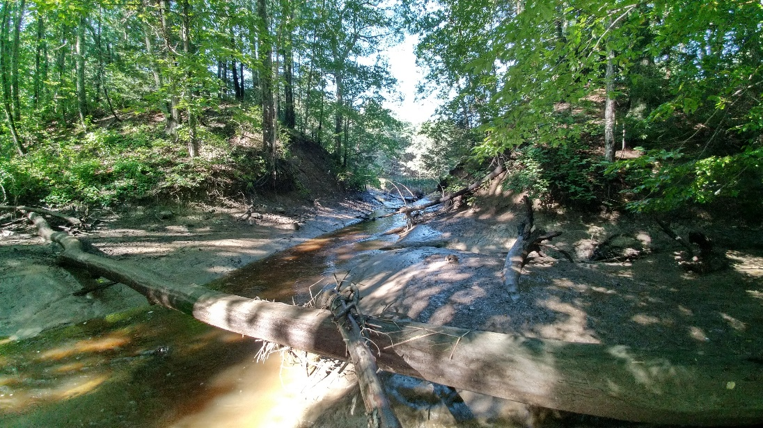
Amtrak Downeaster Railroad Crossing

Slide 11
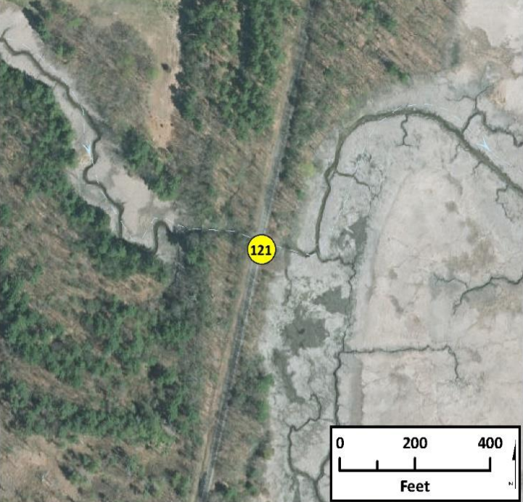
Amtrak Downstream Railroad Crossing
Rocky hill brook is tidal marsh where it crosses under the railroad through a 4- foot-wide and 5.5-foot-tall stone bridge. The crossing condition is poor showing channel constriction and severe erosion, with high tides overfilling the structure on a daily basis. The upstream marsh is more than 0.5 feet lower than the downstream marsh plain, indicating restriction has led to subsidence. The overall combined score is 4, high priority for replacement.

Slide 12
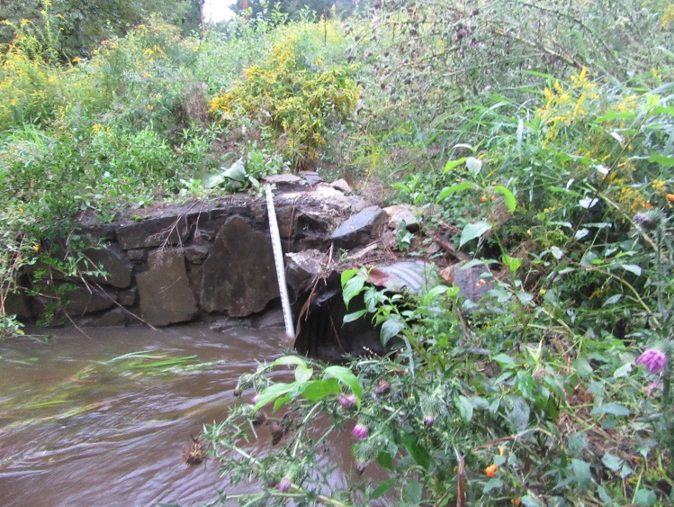
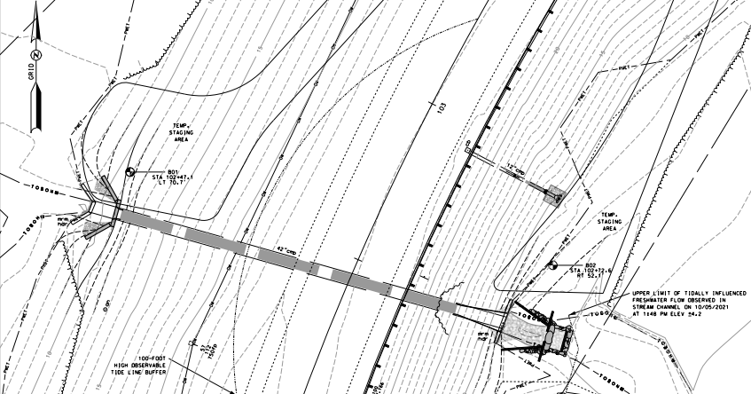
Inlet header prior to construction
Exeter NH Site at Rocky Hill Brook / NH 85

Slide 13
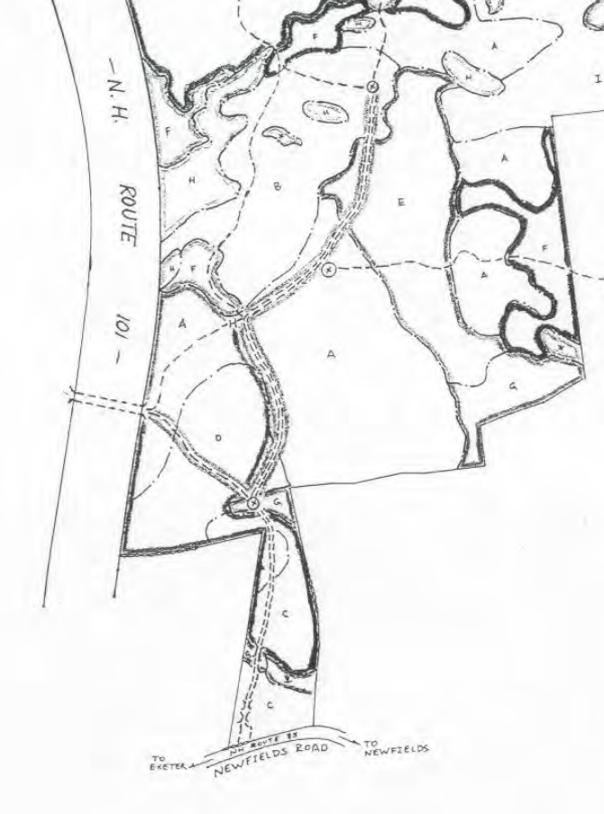
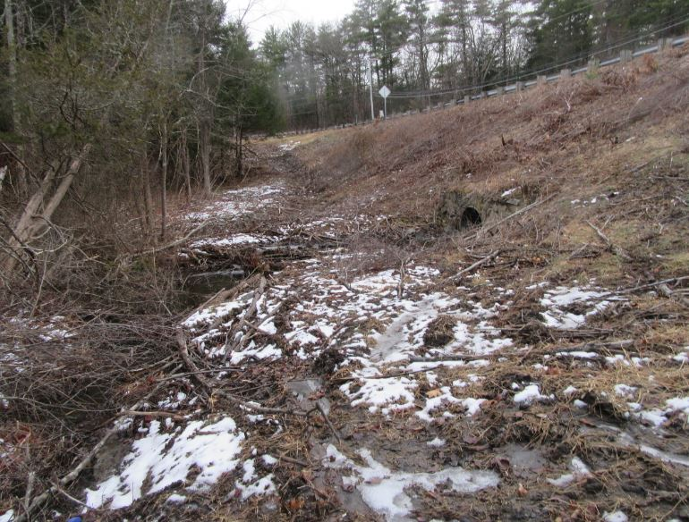
Surface Hydrology
“To be able to examine a topo map, perhaps walk over the ground, and then predict the flood regimen of an ungaged drainage area – that is at once the grand dream and the despair of hydrologists.” Don Johnstone & William P. Cross
Co-author, Elements of Applied Hydrology, 1949
Small watershed (263 acres) conservation / recreation land
Current and Future tidal influence
  Downstream railroad culvert and embankment
Marine Silts and Clays

Slide 14
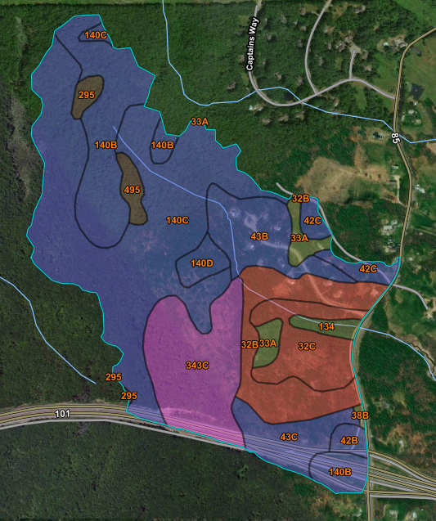
Watershed with HSG Soils Overlayed
Undeveloped
Forested
A_{ws} = 0.41 mi²
Q25 = 98 ft³/s
Q50 = 123 ft³/s
Q100 = 153 ft³/s
Design flows by StreamStats / USGS Regression

Slide 15
Wetland Permits in New Hampshire
Collaboration Process with Natural Resource Agencies in NH
Tier 1 - 4 Crossing based on watershed area and location
Tier 3 is riverine greater than one square mile or Protected Resource Area (PRA)
Tier 4 is coastal which requires vulnerability assessments
“Alternative Design” requirements

Slide 16
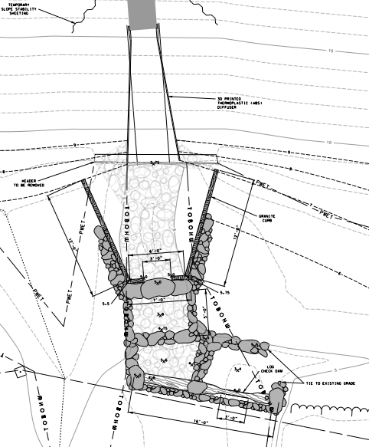
Tier 4 Coastal Wetlands
Vulnerability Assessment
Prime Wetlands
Coastal Resilience
RFMI
  Department concern about rejection of permit
  How the permit constraints changed the design

Slide 17
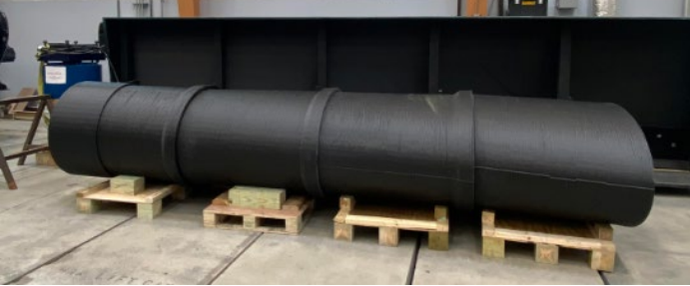
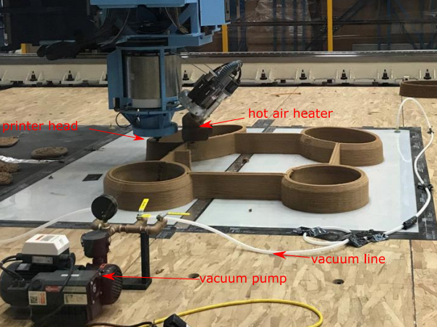
Diffuser Material Design & Fabrication
3d Printing (used for this project)
Another option is fiberglass mold fabrication

Slide 18
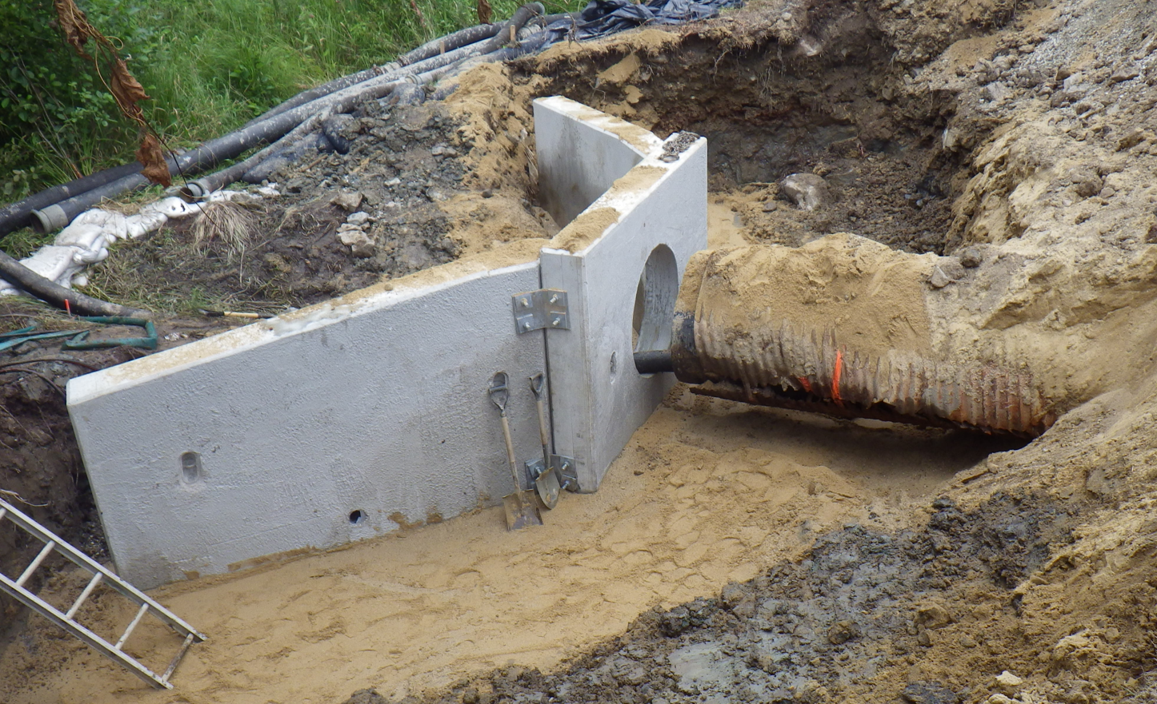
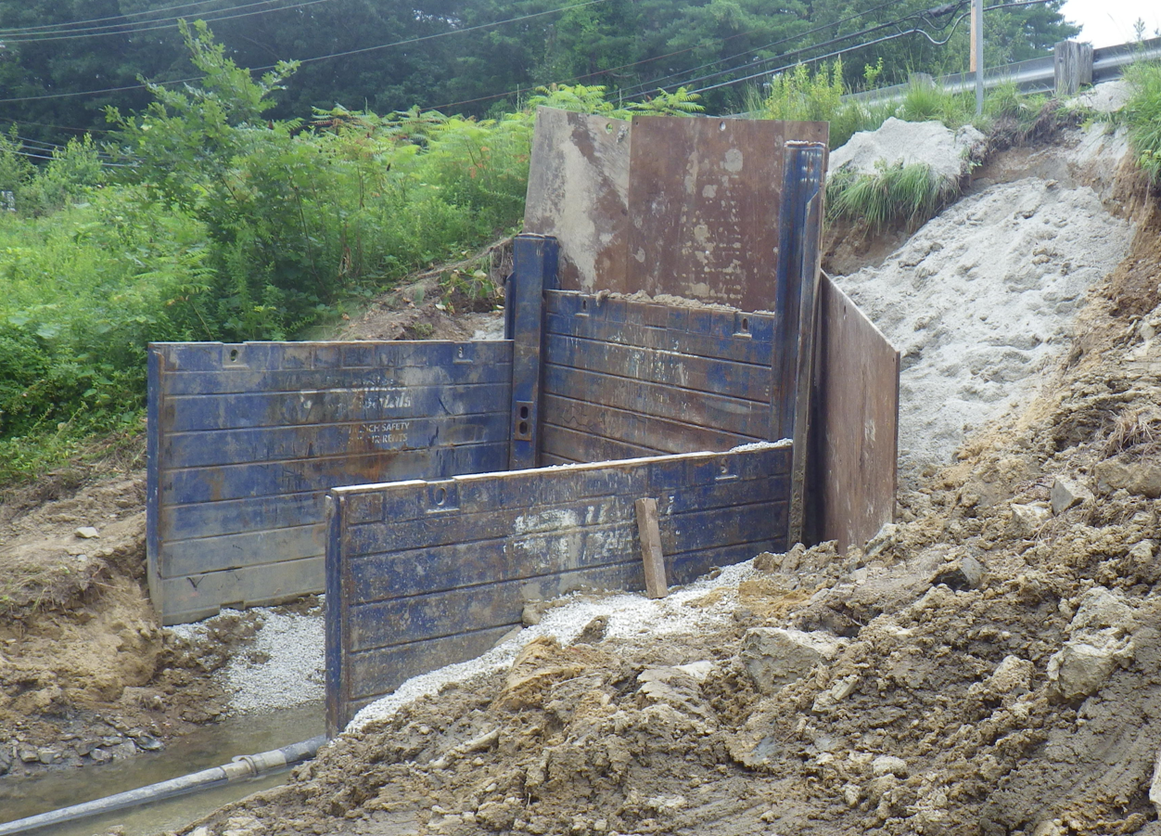
Construction of Inlet & Outlet

Slide 19
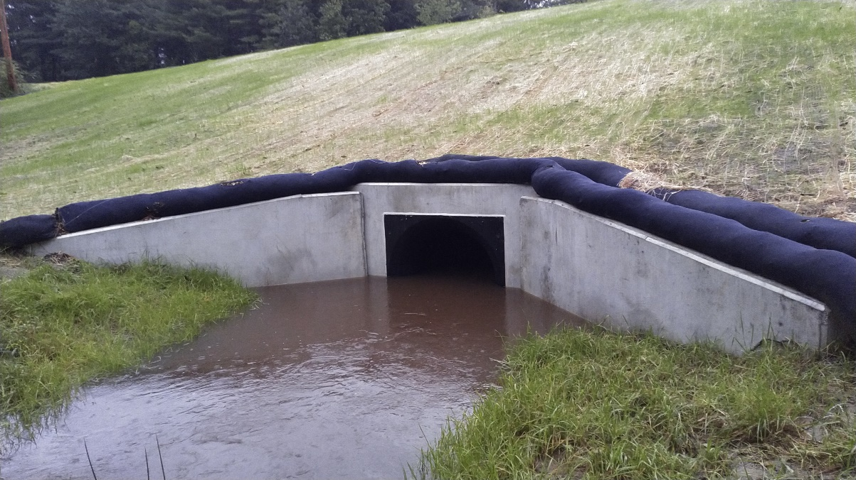
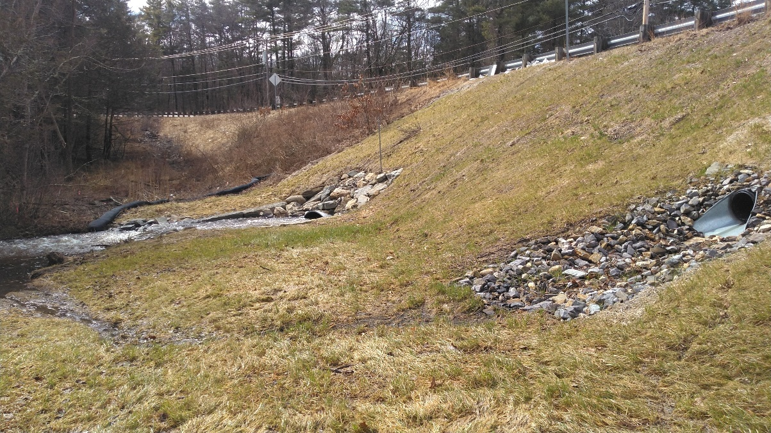
System Performance & Hydraulics
Smooth bore SnapTite liner w/ HydroBell inlet
Increased Capacity with Diffuser
Energy Dissipation
Lower than Typical Outlet Velocity for Rehab.

Slide 20
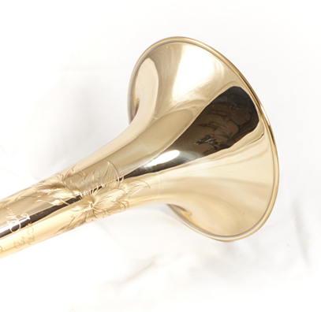
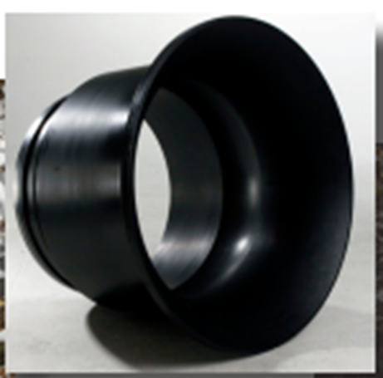
Diffuser Hydraulics – Flared Appurtenance for Reducing Outlet Hydraulic Losses
Similar to “improved inlet” – eliminate sharp contraction
Diffuser – “improved outlet” – eliminate sharp expansion
Best results obtained in conjunction with improved inlet
  This is a system – inlet & outlet
Hydro-Bell by Snap-Tite

Slide 21
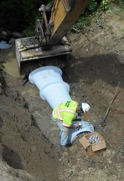

Diffuser Dimensions & Aspect
Rules of thumb for sizing:
L_{D} = 5 x D (11x max.)
D_{D} = 1.414 x D or D + 4/D
A_{D} = 2 x A_{pipe}
L_{D} = 5 x D
D
6º

Slide 22
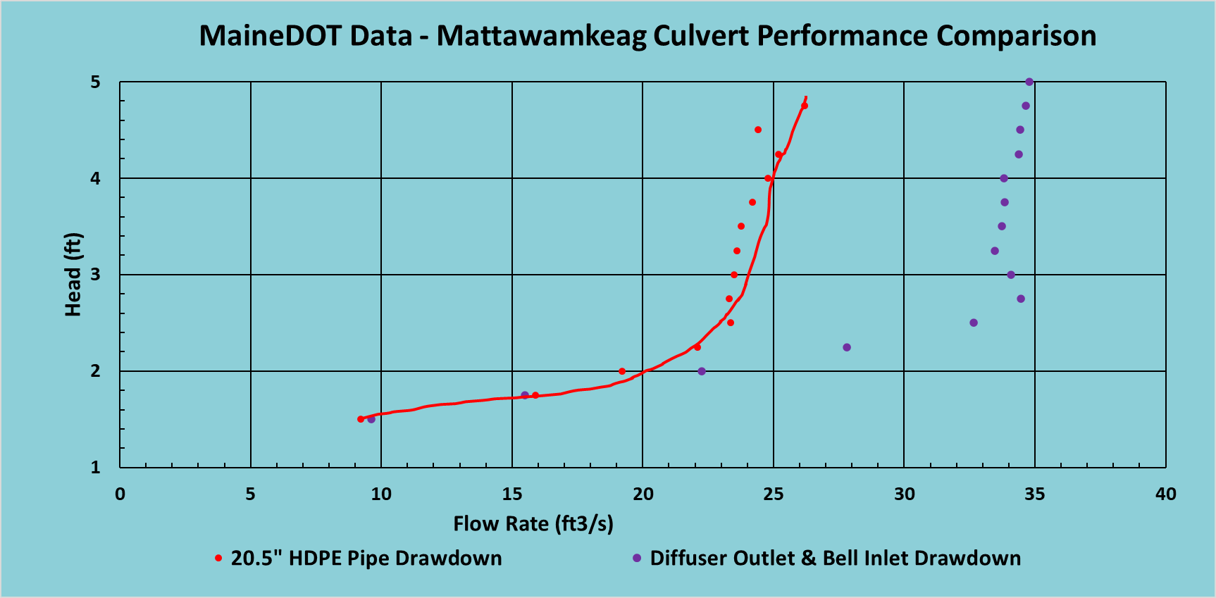
Measured Diffuser System Performance – Mattawamkeag ME
This is REAL data!
Field test on an actual installation
40%+ Increased Capacity
Unimproved pipe
Pipe with Diffuser System

Slide 23
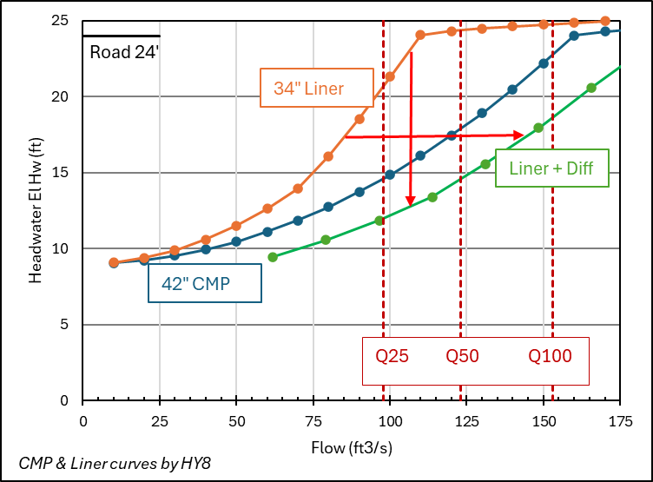
Calculated Diffuser Performance – Exeter NH
Capacity Increase
Outlet Velocity Reduction
Inv 5.3

Slide 24
What Next for the Diffuser?
Diffuser system still at demonstration stage
  2 DOT installations in ME, 1 in NH
Comprehensive research effort by Alex Mann / MaineDOT
  Lit. review, computer modeling, flume demonstration, field testing
To advance application and make the Diffuser System a standard design option:
  NCHRP or Pooled Fund Research effort by professional researchers

Slide 25
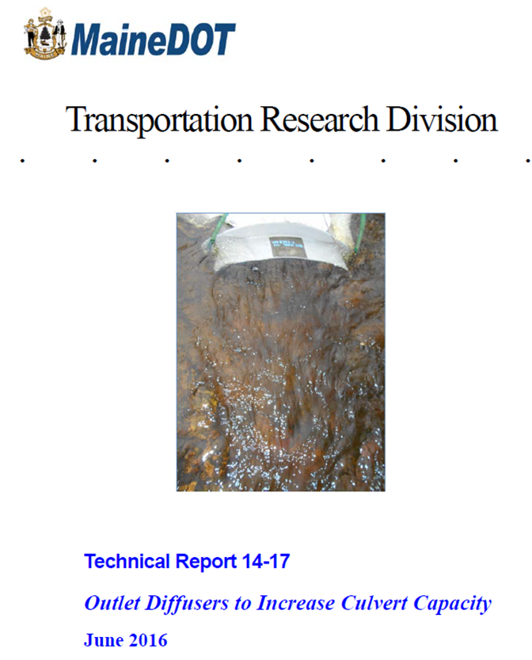
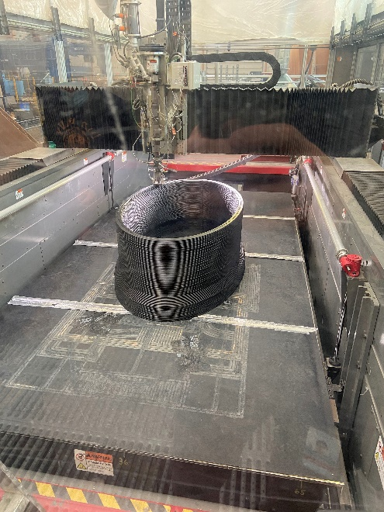
References
www.tidc-utc.org
Large-Scale Extrusion-Based 3D Printing for Highway Culvert Rehabilitation
  Sunil Bhandari, Roberto A. Lopez-Anido, James Anderson, Alex Mann
Durability of Large-Scale 3D Printed Materials for Transportation Infrastructure
Felipe Saavedra, Dept. of Civil Eng. University of Maine, Advisor: Dr. Roberto Lopez Anido

Slide 26
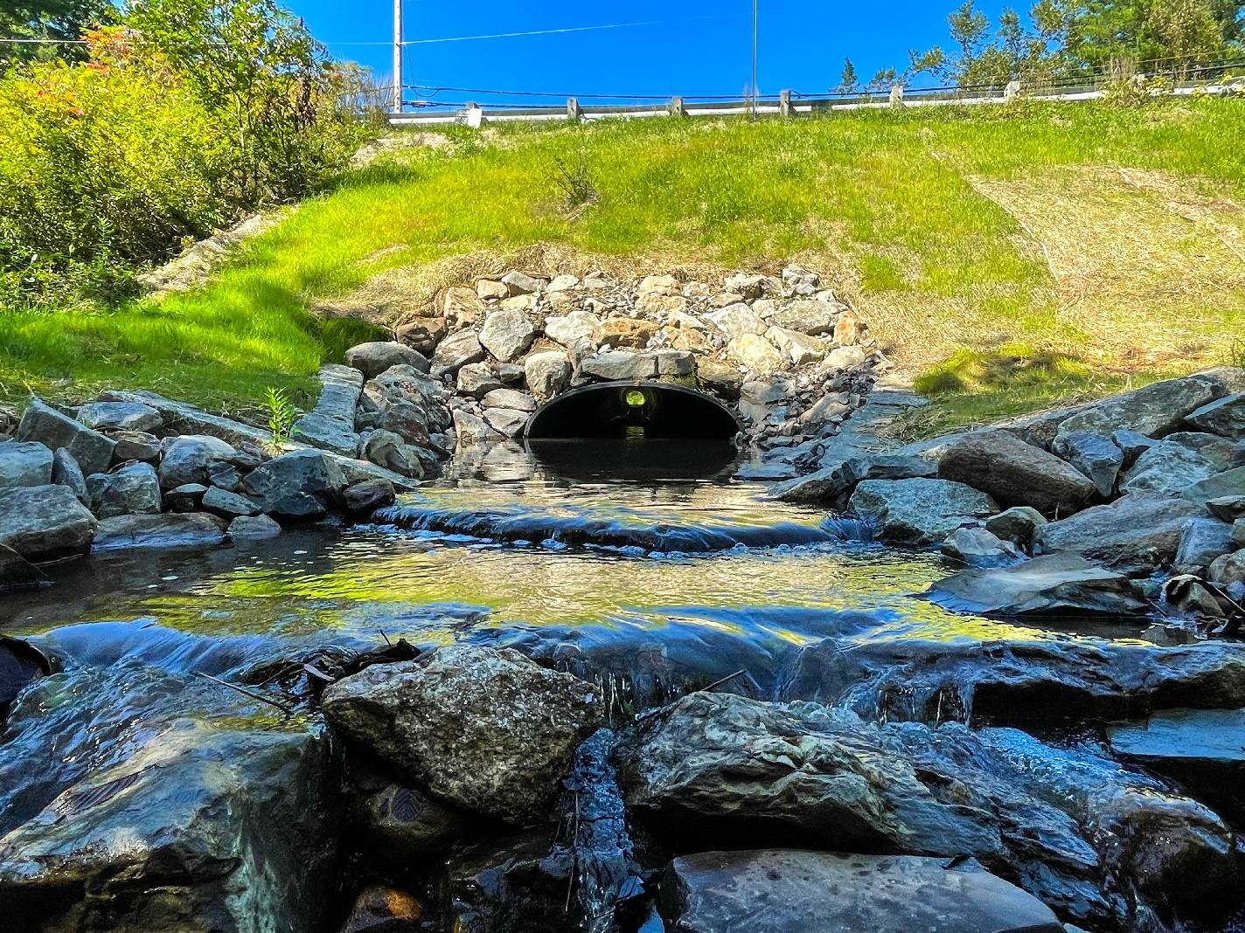
Thank You!
Exeter Diffuser Outlet
Tim Mallette, PE
Group Leader, NHDOT Specialty Section
NH DOT
timothy.s.mallette@dot.nh.gov
603.271.2011
Charles Hebson, PE
Manager, Surface Water Resources Division
MaineDOT / Environmental Office
charles.hebson@maine.gov
207.557.1052
Photo by Univ Maine / TDIC

Slide 27
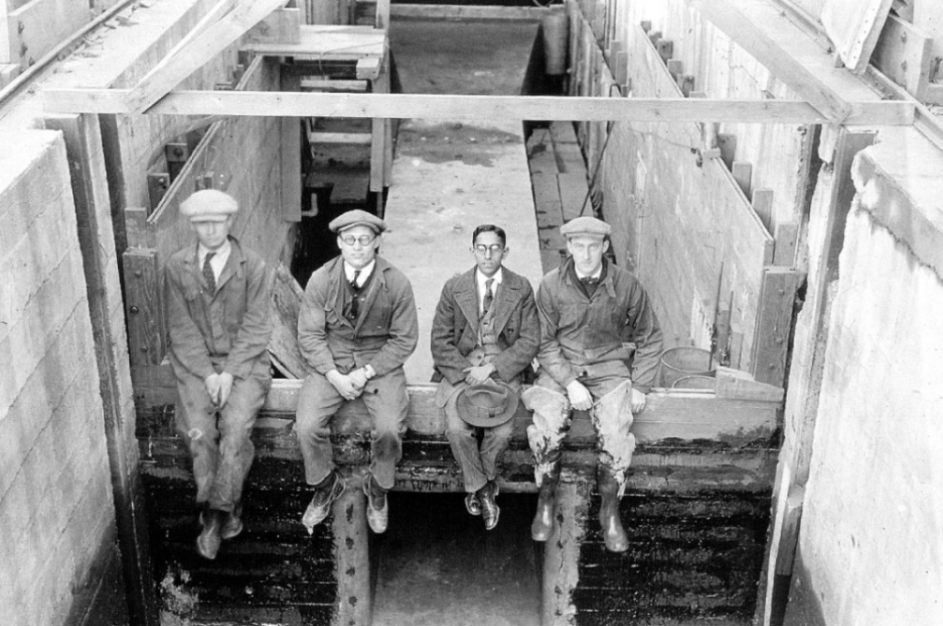
Questions?
David Leroy Yarnell’s 36 ft. Long 3’ x 3’ box culvert and 6’ W by 3’ H diffuser
Courtesy of Archives of the IIHR-Hydroscience and Engineering, The University of Iowa College of Engineering

